Slide 1
CS4104 Applied Machine Learning
Support Vector Machines (SVM)

Slide 2
Support Vector Machines
Find a linear hyperplane (decision boundary) that will separate the data

Slide 3
Support Vector Machines
One Possible Solution

Slide 4
Support Vector Machines
Another possible solution

Slide 5
Support Vector Machines
Other possible solutions

Slide 6
Support Vector Machines
Which one is better? B1 or B2?
How do you define better?

Slide 7
Support Vector Machines
Find hyperplane maximizes the margin => B1 is better than B2

Slide 8
Support Vector Machines

Slide 9

Linear SVM
Linear model:
$f\left(x\right)=\left\{\begin{matrix}1 & if & w.x+b≥1 \\ −1 & if & w.x+b≤−1\end{matrix}\right.$
Learning the model is equivalent to determining the values of $W and b$.
How to find $W and b$ from training data?

Slide 10
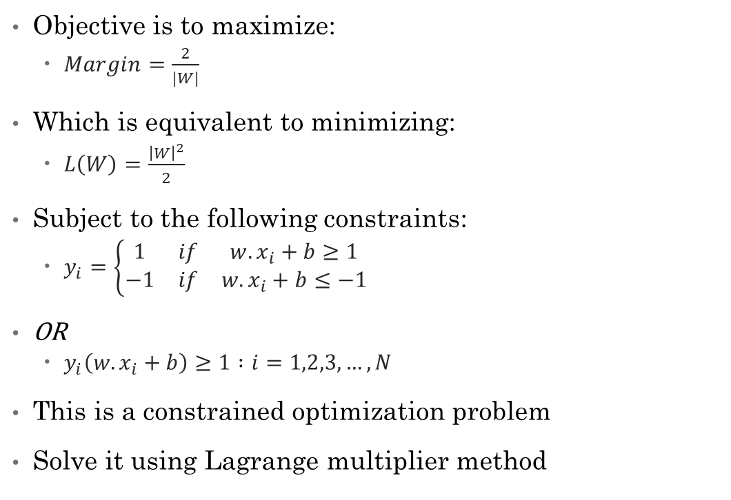
Learning Linear SVM
Objective is to maximize:
$Margin=\frac{2}{|W|}$
Which is equivalent to minimizing:
$L\left(W\right)=\frac{{\left|W\right|}^{2}}{2}$
Subject to the following constraints:
$y_{i}=\left\{\begin{matrix}1 & if & w.x_{i}+b≥1 \\ −1 & if & w.x_{i}+b≤−1\end{matrix}\right.$
OR
$y_{i}\left(w.x_{i}+b\right)≥1 :i=1,2,3,…,N$
This is a constrained optimization problem
Solve it using Lagrange multiplier method

Slide 11
Example of Linear SVM
Support vectors

Slide 12
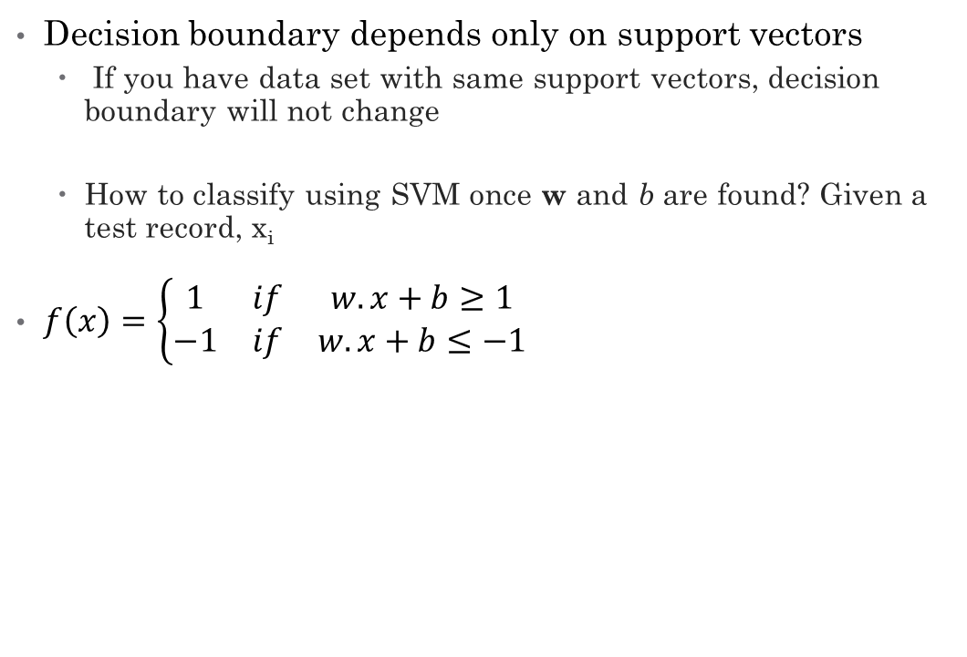
Learning Linear SVM
Decision boundary depends only on support vectors
If you have data set with same support vectors, decision boundary will not change
How to classify using SVM once w and b are found? Given a test record, x_{i}
$f\left(x\right)=\left\{\begin{matrix}1 & if & w.x+b≥1 \\ −1 & if & w.x+b≤−1\end{matrix}\right.$

Slide 13
Support Vector Machines
What if the problem is not linearly separable?

Slide 14
Support Vector Machines
What if the problem is not linearly separable?
Introduce slack variables
Need to minimize:
Subject to:
If k is 1 or 2, this leads to similar objective function as linear SVM but with different constraints (see textbook)

Slide 15
Support Vector Machines
Find the hyperplane that optimizes both factors

Slide 16
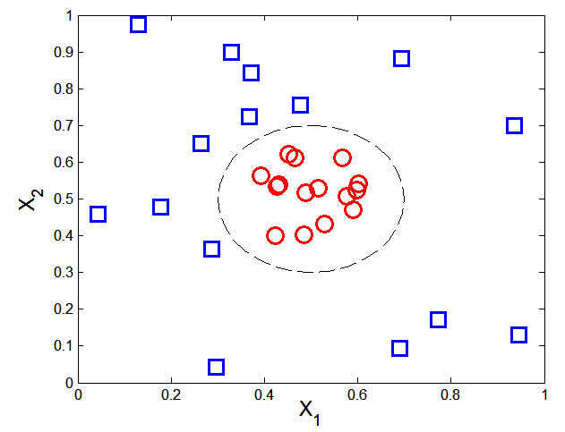

Nonlinear Support Vector Machines
What if decision boundary is not linear?

Slide 17
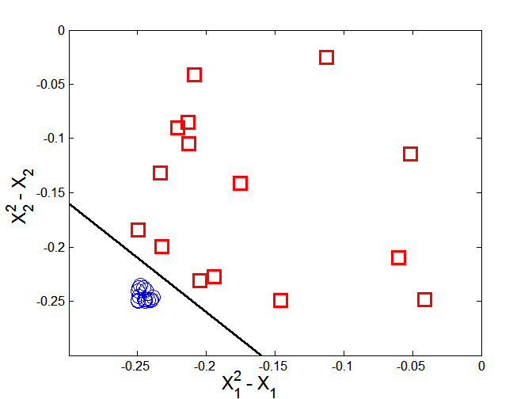



Nonlinear Support Vector Machines
Transform data into higher dimensional space
Decision boundary:

Slide 18
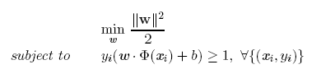

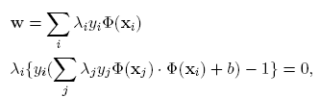

Learning Nonlinear SVM
Optimization problem:
Which leads to the same set of equations (but involve Φ(x) instead of x)

Slide 19
Learning NonLinear SVM
Issues:
What type of mapping function Φ should be used?
How to do the computation in high dimensional space?
Most computations involve dot product Φ(x_{i})• Φ(x_{j})
Curse of dimensionality?

Slide 20

Learning Nonlinear SVM
Kernel Trick:
Φ(x_{i})• Φ(x_{j}) = K(x_{i}, x_{j})
K(x_{i}, x_{j}) is a kernel function (expressed in terms of the coordinates in the original space)
Examples:

Slide 21
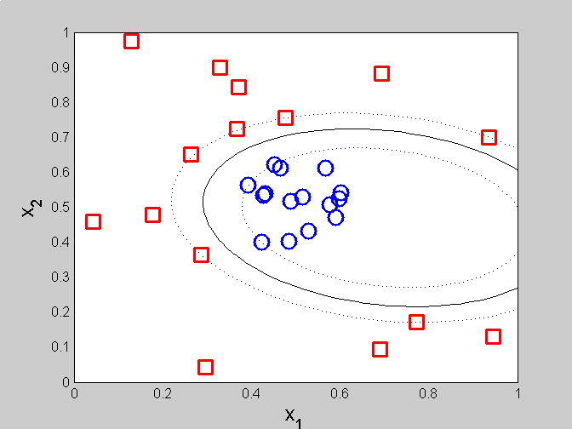
Example of Nonlinear SVM
SVM with polynomial degree 2 kernel

Slide 22
Learning Nonlinear SVM
Advantages of using kernel:
Don’t have to know the mapping function Φ
Computing dot product Φ(x_{i})• Φ(x_{j}) in the original space avoids curse of dimensionality
Not all functions can be kernels
Must make sure there is a corresponding Φ in some high-dimensional space
Mercer’s theorem (see textbook)

Slide 23
Characteristics of SVM
The learning problem is formulated as a convex optimization problem
Efficient algorithms are available to find the global minima
Many of the other methods use greedy approaches and find locally optimal solutions
High computational complexity for building the model
Robust to noise
Overfitting is handled by maximizing the margin of the decision boundary,
SVM can handle irrelevant and redundant better than many other techniques
The user needs to provide the type of kernel function and cost function
Difficult to handle missing values
What about categorical variables?

